Slide 1
Manage Incidental Findings in MR research using REDCap
A User Introduction
Kathleen Durkin
Director, MR Platform Administration

Slide 2
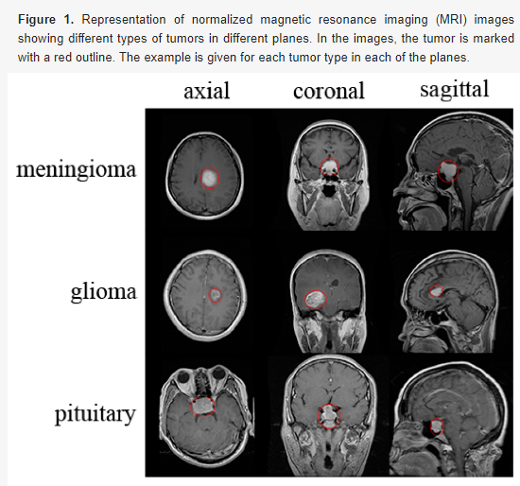
Incidental Findings
An incidental finding is “an incidentally discovered mass or lesion, detected by CT, MRI, or other imaging modality performed for an unrelated reason.”
-American College of Radiology
Incidental imaging findings provide an opportunity to diagnose presymptomatic disease. The IRB requires them.
This could save your participant’s life.
Notes:
We look inside people’s brains all day long. We absolutely will find unexpected things in there.
Definition from https://www.acr.org/Clinical-Resources/Incidental-Findings#:~:text=An%20incidental%20finding%2C%20also%20known,performed%20for%20an%20unrelated%20reason.%E2%80%9D
Image from Classification of Brain Tumors from MRI Images Using a Convolutional Neural Network by Milica M. Badža 1,2, andMarko Č. Barjaktarović Appl. Sci. 2020, 10(6), 1999; https://doi.org/10.3390/app10061999

Slide 3
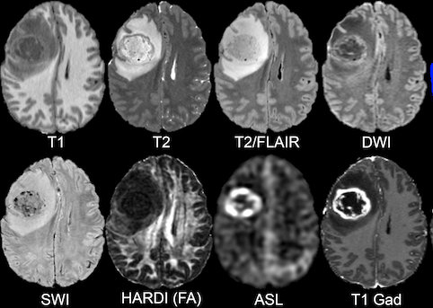
Incidental Findings Process
Send all the images you acquired to Radiology. (Directions at scanner.)
Create a record in REDCap so the radiologist knows it was sent.
The radiologists will do a “Safety read- for Incidental findings (limited read)”.
Notes:
The IRB requires you to send the scan to Radiology. Send all the images you acquire. They say the T1 structural MPRAGE is good for anatomy but the T2 is good for pathology. The glioma in the image looks different in each kind of scan and that’s all helpful information.
A REDCap record is required, or the radiologist won’t know it’s there. More on REDCap on the next slide.
This is called a “Safety read- for Incidental findings (limited read)”. It’s “limited” because it was a research scan, not a clinical scan. The scan parameters were optimized for research purposes, not clinical purposes like a clinical scan would be. (Scheduling note: When scheduling in iLAB, there is a section where the safety read is included by default and a $60 charge is applied. If you are scanning a phantom, fixed tissue, or equipment, you can delete safety read)
Image caption: Lower Grade Glioma segmentation of T2 FLAIR volumes and progression detection. From https://intelligentimaging.ucsf.edu/news/ucsf-diffuse-glioma-mri-dataset-publicly-available-aid-global-research
Your participants’ scans may contain an important incidental finding which could help diagnose a condition at an early phase that is more treatable. An incidental finding can save your participant’s life.

Slide 4
REDCap is a secure web application for building and managing online surveys and databases.
Along with the server that stores the images you send, it serves the same purpose as a PACS system (Picture Archiving and Communication System).
Notes:
But we have to do more than just transfer the scan to Radiology and hope for the best. How will they know it needs to be checked? How will they know where to put the report after they check it? That’s a lot of information. Sounds like we need a shared database.

Slide 5
Getting started with REDCap
Contact the Neurological Institute Administrator Michael Zhang zqz1@cumc.columbia.edu
Request a REDCap account

Slide 6
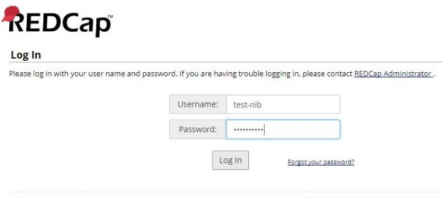
Creating a new REDCap record
Log in at
https://radio-sftp.cpmc.columbia.edu/redcap
Notes:
This creates a ticket for the radiologist.
The radiologist will find the images you sent to RADIO from the scanner in their database and match it with the information you used to register your participant.
These instructions are available in one PDF at https://mr.research.columbia.edu/sites/default/files/content/REDCap%20manual-tech-v.2.pdf

Slide 7
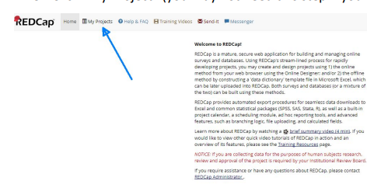
Creating a new REDCap record
Click “My Project”
Notes:
If a REDCap form is not filled out and submitted, the radiologist will not know there is a pending scan to be read.
The information on the REDCap form MUST match the information on the scanner, such as subject ID; otherwise there will be a delay in the safety read.
TWO THINGS MUST HAPPEN:
Images sent to RADIO
REDCap form submitted

Slide 8
Creating a new REDCap record
Click “MRI”
Notes:
If a REDCap form is not filled out and submitted, the radiologist will not know there is a pending scan to be read.
The information on the REDCap form MUST match the information on the scanner, such as subject ID; otherwise there will be a delay in the safety read.
TWO THINGS MUST HAPPEN:
Images sent to RADIO
REDCap form submitted

Slide 9
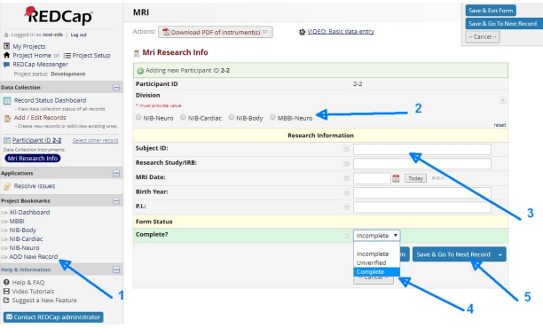
Creating a new REDCap record
Click “Add New Record”.
Choose one division.
Complete the form ACCURATELY
Choose “Complete”.
Click “Save & Exit Form”.
Notes:
ACCURACY is critical for the subject ID. It has to be the exact same ID as was entered at the scanner. Don’t mix up Is and 1s, Os and 0s, dashes and underscores, caps and lower cases. Get it exactly right. Errors waste radiologist time and can incur a penalty fee. The radiologist will not find the images and will not do the read. Without a read, you will not be meeting IRB requirements and your participant might be worse off.
If a REDCap form is not filled out and submitted, the radiologist will not know there is a pending scan to be read. If there are errors, they will not be able to find the scan to read it.

Slide 10
Creating a new REDCap record
To be in full IRB compliance, TWO THINGS MUST HAPPEN:
Images sent to Radiology
REDCap form submitted
Notes:
ACCURACY is critical for the subject ID. It has to be the exact same ID as was entered at the scanner. Don’t mix up Is and 1s, Os and 0s, dashes and underscores, caps and lower cases. Get it exactly right. Errors waste radiologist time and can incur a penalty fee. The radiologist will not find the images and will not do the read. Without a read, you will not be meeting IRB requirements and your participant might be worse off.
If a REDCap form is not filled out and submitted, the radiologist will not know there is a pending scan to be read. If there are errors, they will not be able to find the scan to read it.

Slide 11
Video file of setting up the REDCap Record
https://streamable.com/fmexa8

Slide 12
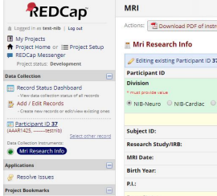
Check for Safety Read Completion
In 10 business days or sooner, log into REDCap again.
Check the left side “Data Collection” section, under “MR Research Info”.
A completed safety read with a radiologist review will have “Mri Safety Read” with a check mark like this:

Slide 13
PDF with Step by Step REDCap
https://mr.research.columbia.edu/sites/default/files/content/REDCap%20manual-tech-v.2.pdf

Slide 14
Categories of incidental findings
Level 1 no medically significant findings. No follow up needed.
Level 2=Class B minor finding
Level 3= Class A-2 abnormal finding
Level 4= Class A-1 acute abnormal finding . The participant should go to the emergency department immediately.
Notes:
You don’t need to know these-- the radiologist knows them-- but they’re sort of interesting.
Level 1 no medically significant findings. No follow up needed.
Level 2=Class B minor finding. Participant should follow up with their physician but no specific time frame is recommended and immediate attention is not needed. Examples: Sinusitis, mastoiditis (sinus or bone infections), nonspecific patchy white lesions in subjects less than 60 years old, chronic infarct, chronic trauma, tonsillar ectopia, severe generalized atrophy, focal atrophy (e.g., isolated brainstem and/ or cerebellum), small meningioma (<3 cm) without edema or cranial nerve or brian stem involvement and possible demyelinating disease (non-enhancing).
Level 3= Class A-2 abnormal finding. Expedited medical evaluation within 2 weeks is recommended. Examples: aneurysm, other vascular malformation (e.g., cavernous or AVM), mass or infiltrating lesion with minimal edema or mass effect (e.g., glioma, small possible metastases), possible acute demyelinating of inflammatory (e.g., Lyme) disease with enhancement.
Level 4= Class A-1 acute abnormal finding . The participant should go to the emergency department immediately. Examples: acute infarct, acute hemorrhage, mass with prominent edema or brain compression (intra or extra axial), acute hydrocephalus.

Slide 15
Communicating incidental findings
Columbia’s IRB states “a plan for notifying the subject of an IF of Clinical Significance. Communication with the subject is the responsibility of the PI. However, if the PI is not a physician or is otherwise not qualified to discuss the IF with the subject, such communication should include a medical professional who is knowledgeable about the type of IF found and who is experienced in communicating sensitive medical information.”
What’s the plan at Zuckerman?

Slide 16
Communicating incidental findings
If there is an incidental finding (rated Level 2-4; see “Incidental Finding Levels” on slide 14), the PI calls the participant to communicate the finding and provide advice on the next steps they should take.
OR
The PI can pay an MD $250 to research the finding and call the participant. In this case, the PI emails the radiology read (in the form of an anonymized PDF) to the MD. Neurology resident who has agreed to make the calls:
Francesco Michaelassi MD
fem2104@cumc.columbia.edu
773-848-2739
(Also notify Kathleen Durkin to coordinate payment.)

